Slide 1


Subawards and Other Types of Agreements
Presented by:
Mandy Wilcox

Slide 2

Module 8
Post-Award (Session 2)
Subawards and Other Types of Agreements
Exploring Research Administration…for CONCEPT to COMMERCIALIZATION

Slide 3
Other Agreements
General Information
An “Other Agreement” is an agreement in which there is no funding and is also referred to as a “non-consideration agreement”
Examples
Non-Disclosure Agreement (aka Confidentiality Agreement, Proprietary Information Agreement, etc.)
Teaming Agreement
Master Agreement
Equipment Loan Agreement
Material Transfer Agreement (Biological/Non-biological)
Memorandum of Understanding
Subawards and Other Types of Agreements

Slide 4
Other Agreements
Non-Disclosure Agreement
A legal contract between at least two parties that outlines confidential material, knowledge, or information that the parties wish to share with one another for certain purposes, but wish to restrict access to or by third parties. It's a contract through which the parties agree not to disclose information covered by the agreement.
Subawards and Other Types of Agreements

Slide 5
Other Agreements
Things to Consider
Who is disclosing/receiving the information?
What is confidential information?
What isn’t confidential information?
What is the term?
How long does the receiving party have to keep the confidential information confidential?
What happens to the information once the obligations of the agreement are over?
Subawards and Other Types of Agreements
Notes:
Doshie will collect sign in sheets and create classes in the UCF HR online training history.

Slide 6
Other Agreements
Teaming Agreement
A Teaming Agreement involves two or more entities combining resources to bid on a government contract that they may not be able to obtain and perform individually.
Identifies:
the prime recipient
Responsibilities of each party for proposal preparation
Assignment of proposal costs
Subawards and Other Types of Agreements
Notes:
Doshie will collect sign in sheets and create classes in the UCF HR online training history.

Slide 7
Other Agreements
Things to Consider
Are we eligible to submit a proposal under the solicitation?
Does the PI agree to be included in the proposed relationship?
What happens during the proposal period?
What happens if the proposal is awarded?
What happens if the proposal is declined?
Are there restrictions for other teaming opportunities?
Subawards and Other Types of Agreements

Slide 8
Other Agreements
Master Agreement
Type of contract used to consolidate multiple contracts between the same two parties. This agreement can serve as an agreement between the parties to address most of the terms governing future transactions, which will allow the parties to quickly put in place future transactions because they rely on the terms of the master and only need to negotiate project-specific terms.
Subawards and Other Types of Agreements

Slide 9
Other Agreements
Things to Consider
Remember, this contract will potentially affect faculty across campus.
How are the individual tasks awarded?
Subawards and Other Types of Agreements

Slide 10
Other Agreements
Equipment Loan Agreement
An agreement used when one party agrees to allow another party to use equipment in connection with a research project for a specified period of time.
Subawards and Other Types of Agreements

Slide 11
Other Agreements
Things to Consider
UCF specific - How was the item purchased (sponsored project, department account, etc.)?
UCF specific - Is it decaled?
Do we have access to the equipment while loaned?
Who will be responsible for shipping, maintenance, etc.?
What happens if there is damage to the equipment?
Is there a provision regarding the difference between damage and normal wear and tear?
Who pays for installation/de-installation and related costs?
Subawards and Other Types of Agreements

Slide 12
Other Agreements
Material Transfer Agreement
A contract that governs that transfer of tangible research materials between two organizations, when the recipient intends to use it for their own research purposes.
Subawards and Other Types of Agreements

Slide 13
Other Agreements
Things to Consider
Who is providing/receiving the material?
What are the terms/restrictions on the use of the materials?
Are there compliance issues (i.e. export control, IRB, IACUC)?
What about potential IP/derivatives made from the material?
Will the material be required to be returned?
Subawards and Other Types of Agreements

Slide 14
Other Agreements
Memorandum of Understanding
A document describing joint agreement between two or more parties. It expresses shared viewpoints between the parties, indicating an intended common line of action
Subawards and Other Types of Agreements

Slide 15
Other Agreements
Question
As with other agreements an MOU is duly signed by authorized representatives of the parties. With this said, does that make an MOU a legally binding agreement?
Subawards and Other Types of Agreements

Slide 16
Other Agreements
Answer
No. A binding contract depends only on the presence or absence of well-defined legal elements in the text of the document.
Subawards and Other Types of Agreements

Slide 17
Other Agreements
Things to Consider
What is the anticipated outcome of executing an MOU?
Do we have agreements for consideration with the other party?
Is this a requirement of a solicitation?
Is there a project in mind?
Is this the best document to establish a relationship?
Subawards and Other Types of Agreements

Slide 18
Subawards
Who is a Subrecipient?
Per OMB Circular A-133 a subrecipient is: “A non-Federal entity that expends Federal awards received from a pass-through entity to carry out a Federal program, but does not include an individual that is a beneficiary of such a program. A subrecipient may also be a recipient of other Federal awards directly from a Federal awarding agency.”
Subawards and Other Types of Agreements

Slide 19
Subawards
What are the Types of Subrecipients
Subcontractor/Subgrantee
Consultant
Vendor
What is the difference?
Subawards and Other Types of Agreements

Slide 20
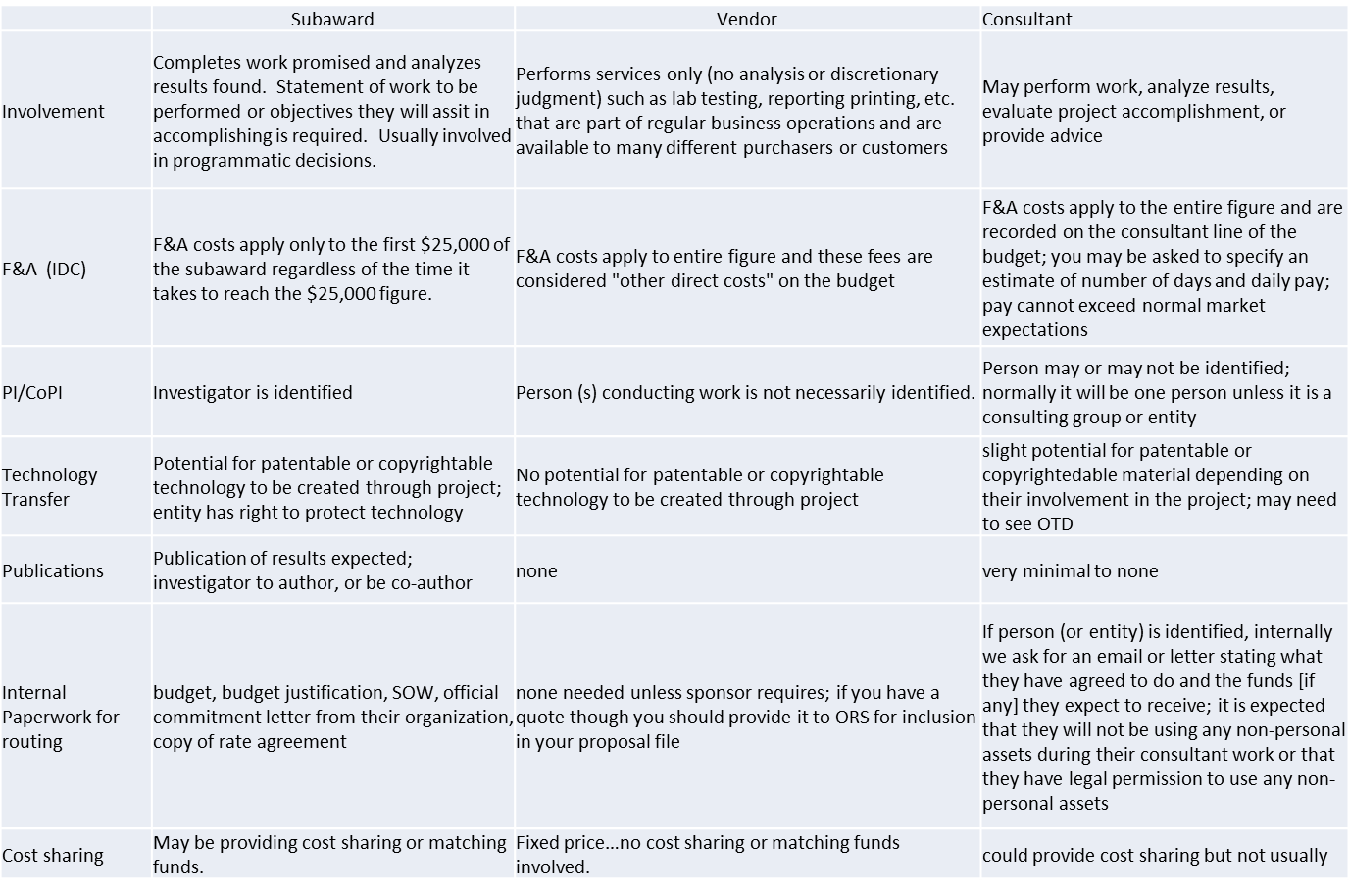
Subaward v. Vendor v. Consultant
Subawards and Other Types of Agreements

Slide 21
Subawards
What Information do We Need?
Pre-Award
Subrecipient Commitment Form
Budget/Budget Justification
a clearly defined, intellectually significant Statement of Work (SOW) to be performed
Subawards and Other Types of Agreements

Slide 22
Subawards
What Information do We Need?
Post-Award
Formal written agreement
a clearly defined, intellectually significant Statement of Work (SOW) to be performed
Deliverables
Monitor!
Subawards and Other Types of Agreements

Slide 23
Subawards
Scenario
UCF was awarded a $55 million NASA grant to build and launch into space an instrument the size of a microwave oven that will provide unprecedented imaging of the Earth’s upper atmosphere. The award is the largest single grant in UCF’s history, and UCF will become the first Florida university to lead a NASA mission.
The information collected by the Global-scale Observations of the Limb and Disk (GOLD) mission will have a direct impact on understanding space weather – such as solar wind – and its impact on communication and navigation satellites, which we’ve come to rely on for everything from television programming to cell phone coverage and GPS in our vehicles.
The information may also lead to advances in directing airline traffic in a safer manner by providing a greater understanding of how space elements impact communication signals.
Subawards and Other Types of Agreements

Slide 24
Subawards
 | Subaward (LASP) | Vendor (SES) | Consultant (Dr. Harvey)
Involvement | Responsible for Project Management, development and implementation of the GOLD instrument (a two-channel Far Ultraviolet [FUV] spectrograph), system engineering, safety and mission assurance, instrument operations, and science support. | spacecraft accommodation | May perform work, analyze results, evaluate project accomplishment, or provide advice
F&A (IDC) | F&A costs apply only to the first $25,000 of the subaward. | F&A costs apply to entire figure and these fees are considered "other direct costs" on the budget | F&A costs apply to the entire figure and are recorded on the consultant line of the budget
PI/CoPI | Dr. McClintock, Rory Barrett and Mark Lankton | None identified | Dr. Harvey
Technology Transfer | Instrument based on background IP and improvements thereof for this project. | No potential for patentable or copyrightable technology to be created through project | slight potential for patentable or copyrightedable material depending on their involvement in the project
Publications | Publication of results expected; investigator to author, or be co-author | none | very minimal to none
Internal Paperwork for routing | Detailed budget in terms of calendar year, government fiscal year, FTE, WBS, by category, etc., Budget justification, subrecipient commitment form, rate agreement, fringe benefits rate memo, procurement quotes, etc. | Quote for service | Quote for tasks to be complete (to include number of hours per task and amount per hour)
Subawards and Other Types of Agreements

Slide 25
Subawards
Things to Consider
Flow-Down Provisions
What are the terms that were given to UCF?
What type of entity will receive the subcontract?
Does the subcontract meet any specific dollar threshold that trigger the inclusion of certain terms?
What are the requirements of the Federal Acquisition Regulations (and any subsequent supplements?
Subawards and Other Types of Agreements

Slide 26
Subawards
Things to Consider
Pre-Award
What documents need to be collected prior to submission?
Is the subcontractor entered into ARGIS?
What RFP terms need to be discussed at time of proposal?
Do limited rights need to be asserted to the Government?
Subawards and Other Types of Agreements

Slide 27
Subawards
Things to Consider
Post-Award
What type of subrecipient are we awarding?
What is the most appropriate award type?
Do the budget and SOW need to be renegotiated?
Are all commitment forms and information on file?
What terms are we required to flow down?
Subawards and Other Types of Agreements

Slide 28

THANKS FOR JOINING US!
See you at the next session:
F&A Rates and Service Centers
September 25, 2013
10:00 am to 12:00 pm
ORC 2nd floor large (#211)

